Slide 1
distributive denial of service attack detection using cat-boost algorithm in machine learning
Presented By :
1. Dharanidharan A – (21AI008)
2. Kirubasankar K R – (21AI020)
3. Mohamaad Ishaaq S – (21AI027)
4. Navaneetha Krishnan S – (21AI030)
Guided By :
Mrs. Parvathi M, M.E.
Assistant Professor – AI & DS
Nandha Engineering College.
24UG-AI009
FIRST REVIEW

Slide 2
Abstract
DDOS (Distributive denial of service) attacks which works by overloading the server with multiple connections at the same time, making the site unable to take anymore requests. This work is done on ubuntu operating system with tools such as mininet virtual machine which helps in detecting the attack. The current existing system is done on the algorithm named as “random forest” whereas in this project the current algorithm is replaced with a different one to operate which is “catboost”. It works on the principles of categorizing the data’s by assigning values of the same class together.

Slide 3
Objectives of the Project
The primary objective of our project is to detect Denial of service attacks using catboost algorithm.
Its helps user to identify the DDOS attack from hackers by identifying their IP address to find out their location.
It is also used to detect their attack type on which attack category is used to flood our internet packets.

Slide 4
Existing system
The Random Forest method, which uses the idea of decision trees to categorize and identify harmful traffic.
The existing system from the base paper is to detect the DDOS attack using the random forest algorithm and detect the DDOS attack at the rate of 98 percentage with the average speed and the accuracy.
In order to increase accuracy and decrease overfitting, this method entails building many decision trees during training and combining their output.
Utilizing technologies like Mininet,which mimics network settings which serves as a framework for controlling the virtual machine and identifying threats, the system is deployed on the Linux operating system.

Slide 5
Proposed system
The system that is being suggested—By using the CatBoost algorithm, which is an advancement over the conventional Random Forest-based detection technique, the suggested system seeks to improve the detection of Distributed Denial of Service (DDoS) assaults.
The system is set up on an Linux- based environment utilizing Mininet within a virtual machine. By effectively managing categorical data and enhancing decision- making in real-time assault scenarios
The gradient boosting algorithm CatBoost improves detection accuracy. To more accurately categorize and detect malicious activity, the model is trained using network traffic data. CatBoost exhibits better flexibility to a variety of attack patterns and lowers false positive rates when compared to current Random Forest techniques

Slide 6
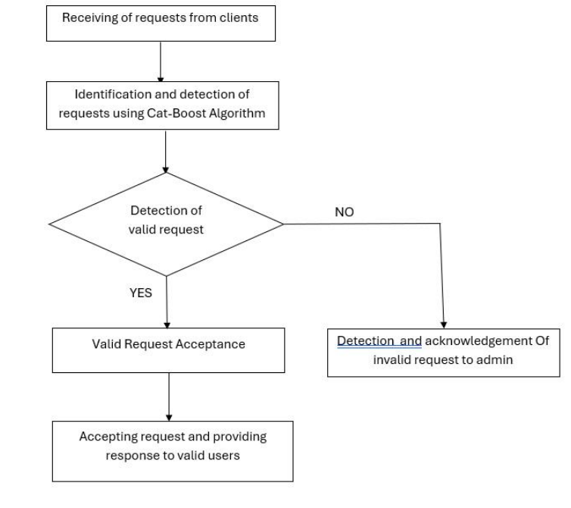
Project Lifecycle

Slide 7
Languages used
Python:
Python is the most commonly used language in machine learning projects due to its extensive libraries and frameworks.
Libraries such as CatBoost,Pandas, NumPy would be used for data preprocessing, model training, evaluation and visualization.

Slide 8
Modules
Module used to collect network packets : Pyshark
Algorithm implemented : Catboost
Attacking module : Hping3

Slide 9
Module Description
Pyshark:
It is used for capturing and analyzing network traffic. It extracts features such as packet size, protocol type, source/destination IP and timestamps.It provides raw network traffic data for preprocessing.
Cat-Boost:
A machine learning algorithm for classification tasks.It Handles categorical features efficiently, which is useful for network traffic data.It provides high accuracy and performance for DDoS detection.
Hping3:
Hping3 is a tool used in Kali-Linux operating system which is used to demonstrate the flooding of a network address used for educational purposes only

Slide 10
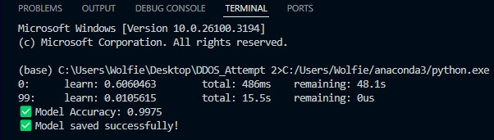
Terminal Screenshots

Slide 11
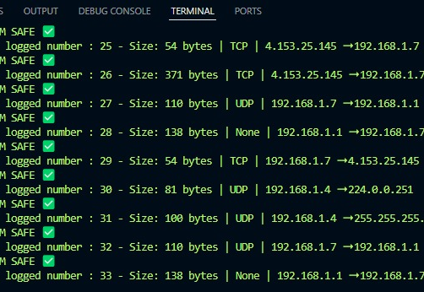
Screenshot of legal request from users

Slide 12
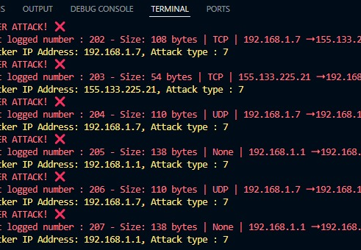
Screenshot of illegal request from users

Slide 13
Application of the project
Cybersecurity for Online Services
Network Traffic Monitoring
Intrusion Detection Systems (IDS)
E-commerce Platforms
Educational and Research Purposes
Cloud Service Providers

Slide 14
Conclusion
The main purpose of DDOS detection system is to detect the DDOS attack from hackers and to indicate the users about the attack to protect their system. It works using the Cat-Boost method, which categorizes data by assigning values that belong to the same class, in contrast to the current system that uses the Random Forest algorithm based on decision trees. Cat-Boost improves detection accuracy over the traditional method by efficiently applying gradient boosting to decision trees for data categorization. This technique simprove the network's security and resilience by enhancing the system's ability to distinguish between malicious and legal traffic

Slide 15
References:
H.S. Abdulkarem and A. Drawod, “DDoS attack detection and mitigation at SDN data plane layer,” in Proc.2nd Global Power , Energy Common Conf. (GPECOM), oct 2020.pp. 322-326.
J. Ye, X. Cheng, and J. Zhu, ‘‘A DDoS attack detection method based on SVM in software defined network,’’ Secur. Commun. Netw., vol.2018, Apr. 2018, Art. no. 9804061.
S. Dong, K. Abbas, and R. Jain, ‘‘A survey on distributed denial of service (DDoS) attacks in SDN and cloud computing environments,’’ IEEE Access, vol. 7, pp 80813–80828, 2019.
O. Osanaiye, K.-K.-R. Choo, and M. Dlodlo,‘‘Distributed denial of service (DDoS) resilience in cloud Review and conceptual cloud DDoS mitigation framework,’J. Netw. Comput. Appl., vol. 67, pp. 147–165, May 2016.

Slide 16
References contin....
J. Cui, M. Wang, and Y. Luo, ‘‘DDoS detection and defense mechanism based on cognitive-inspired computing in SDN,’’ Future Gener. Comput.Syst., vol. 97, pp. 275–283, Aug.2019.
W. Zhijun, X. Qing, W. Jingjie, Y. Meng, and L.Liang, ‘‘Low-rate DDoS attack detection based on factorization machine in software defined network,’’ IEEE Access, vol. 8,pp. 17404–17418, 2020.
E. Adi, Z. Baig, C. P. Lam, and P. Hingston, ‘‘Low-rate Denial-of-Service attacks against HTTP/2 services,’’in Proc. 5th Int. Conf. IT Converg. Secur.(ICITCS), Aug.2015.
M. Baskar, T. Gnanasekaran, and S. Saravanan,‘‘Adaptive IP traceback mechanism for detecting low rate DDoS attacks,’’ in Proc. IEEE Int. Conf.Emerg.Trends Comput., Commun. Nanotechnol. (ICECCN),Mar. 2013.

